Slide 1

Commerce
Data Service
New Employee Handbook
May 11, 2016

Slide 2













The US Department of Commerce creates the conditions for economic growth and opportunity

Slide 3
Org Chart
Chief Data Officer
Deputy Chief Data Officer
Lead, Development
Lead, Data Education Initiatives
Chief Data Scientist
Back-End
Front-End
Design
Skills & Education
Data Science
Commerce Data Labs
Sandbox
Commerce Ops
Social Ops

Slide 4
Org Chart
Chief Data Officer
Deputy Chief Data Officer
Ian Kalin
Tyrone Grandison
Lead, Development
Lead, Data Education Initiatives
Chief Data Scientist
Alison Rowland
Natassja Linzau
Jeff Chen
Back-End
Front-End
Design
Skills & Education
Data Science
Commerce Data Labs
Negar Kalbasi
Sasan Bahadaran
Radhika Bhatt
Mark Brown II
Rebecca Bilbro
Star Ying
Priyanka Oberoi
Sandbox
Commerce Ops
Social Ops

Slide 5

The Team

Slide 6
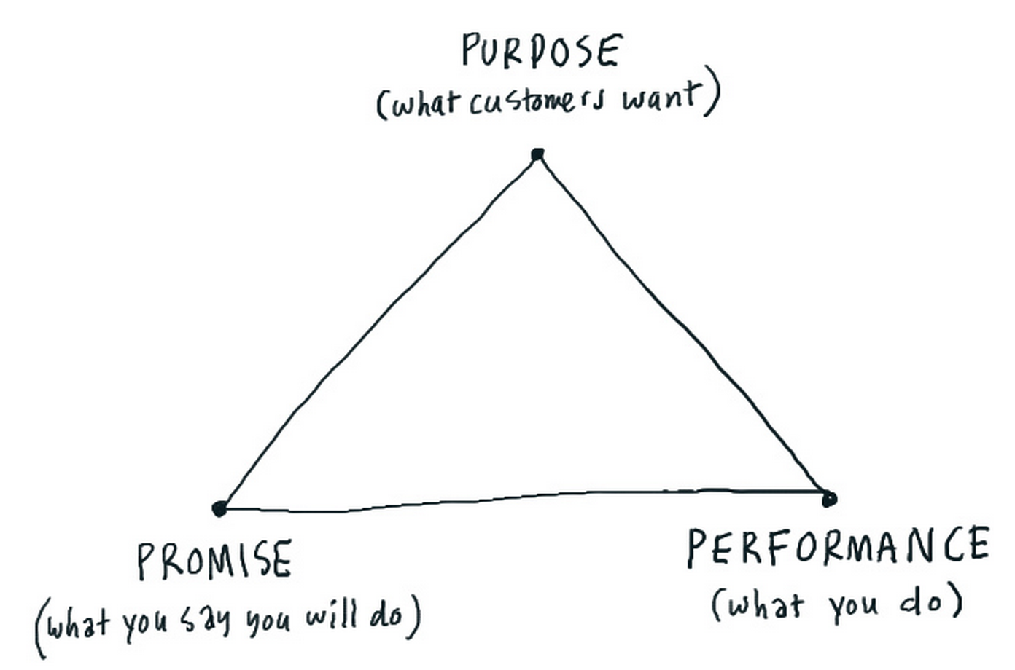
Team MEMBER EXPECTATIONS
Be skilled at communication
Communicating their work (and results) to executives and clients.
Communicating with team members.
Have a collaborative mindset.
Know and practice of Agile and Lean startup methodologies.
Know and practice user-centered design.
Be outcomes-driven.
Work in the open and in community.

Slide 7
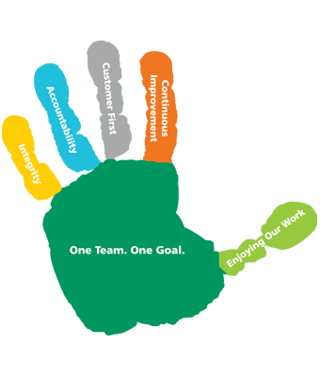
Team values
Open
Everything in public.
Collaboration and Co-creation
No impostors. One team. Ask for help. Partner often. Improve everything.
Communication
Communicate often and meaningfully. Document everything.
Curiosity
Constantly learning. Constantly automating. Constantly teaching.
Fun

Slide 8
OPERATIONAL PRINCIPLES
(Delivery) Project Selection done using a standard decision process.
Project Basics
Each project must have a product owner.
Each project must have a transition plan.
Project risks must be actively managed.
Project Execution: Well-defined sprints - two (2) week durations:
Each sprint has a crisp and well-defined goal.
Each sprint has a tangible deliverable at its end.
Project Management:
All projects should use Github, Github.io and “Github issues” and Waffle.io

Slide 9
OPERATIONAL PRINCIPLES
Team Logistics:
Bi-weekly status updates to the entire Data Service.
At least two standups per team each week.
Project team members is based on project need and may involve a mix of data scientists, data engineers and UI/UX engineers.
Meetings
Should be focused, productive and geared towards goals.
Meetings within the team are either 13 minutes or 25 minutes.
Coordinators should send out an agenda for the meeting at worst 24 hours.
Summaries of client meetings sent to client and leadership team within 24 hours of the meeting.

Slide 10
ENGAGEMENT
Project Scoping
All projects must have some type of scope. This is largely for keeping us honest and CYA with the client.
Project Tracking
All projects are tracked religiously and blockers surfaced immediately.

Slide 11
Six conditions for scoping for awesomeness
Access to the field
Access to actionable resources
A reason for existence
Ethical intervention points
Methodologically defensible yet intellectually accessible
Path to sustainability
Notes:
We’ve worked to develop
Access to valid resources (change to this shakes projects to their core)
can get to the data, people, knowledge
A Reason for Existence (dictates the story and direction of an effort)
A fundamental theory as to why a system or a policy exists or should exist, how it operates, where decisions lie and dependencies
Tying the mission and purpose back to people around you
Ethical intervention points (determines how to drive impact)
Knowing where data can make a change, knowing how data will be used, and for the right purpose
Methodologically defensible yet intellectually accessible (sales with substance)
Achieves and surpasses benchmarks, yet still can be discussed
Path to sustainability (designed like a rock)
Unlike revenue generating services, we want to be in, and get out as soon as the host organization is ready to take over.
Unless you want to be embedded forever and have the resources to do so, invest in the insiders to learn and show it’s not a burden

Slide 12
 | A Reason to Exist | Access to Valid Resources | Methodologically defensible yet intellectually accessible | Ethical Intervention Points | Path to sustainability
Ideas | x | x
Research | x | x | x
Products | x | x | x | x | x
Services | x | x | x | x | x
Notes:
[Slide] And depending on what we’re doing, these criteria shake out differently.

Slide 13

Fifty Thousand Foot View

Slide 14
Mission
To empower people and business through Open Data and Transparency; both within and outside the Department.
To fundamentally change the way people and businesses interact with the DOC.
To super-charge the data initiatives in the DOC's bureaus.

Slide 15

Strategy
Build 21st century data product delivery into the bureaus’ DNA
Making bureaus more data-driven

Slide 16
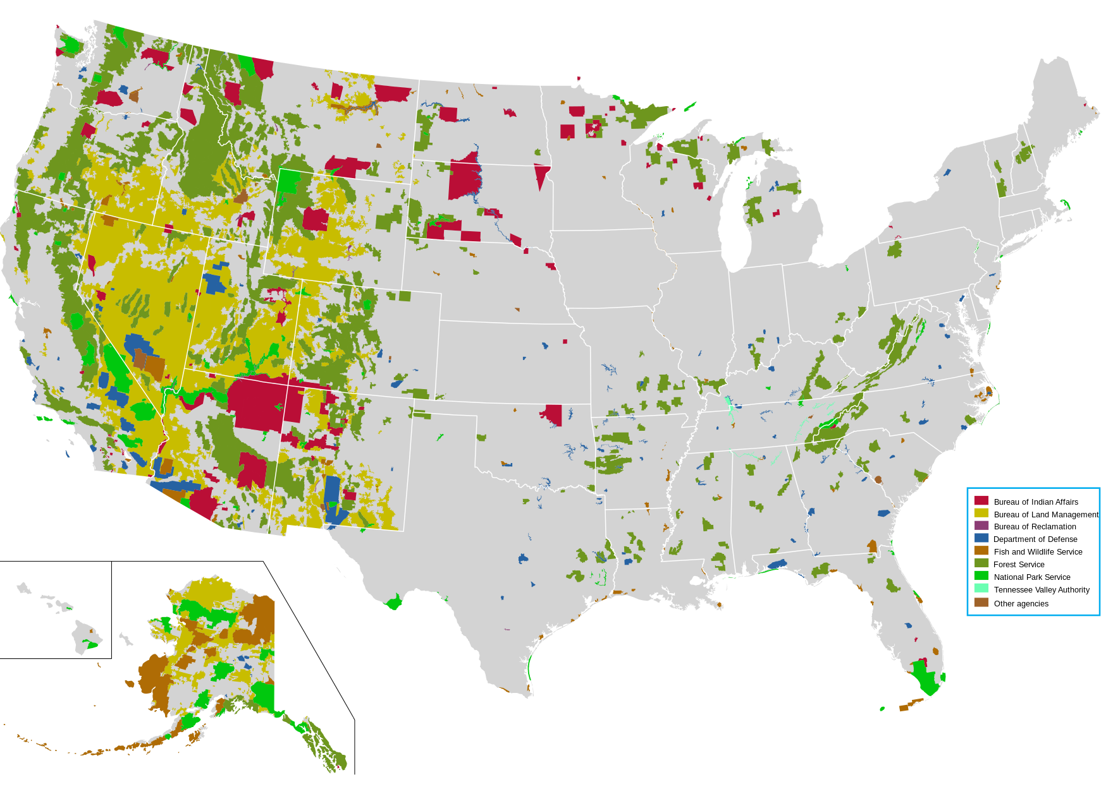
WHat WE DO
we Deliver
we Consult
we Train
we Partner
we Procure
Notes:
1 Deliver
a Research, design and build visually appealing, modern web interfaces and platforms
2 Consult
a Provide guidance on developing and executing data + tech roadmaps
b Assess current state and direction of a project and identify points for enhancement
c Collaboratively set flexible and functional policies to enable the use of tools, services, and software across DOC
d Identify new improvement opportunities and provide a strategic framework for acting on these opportunities
3 Train
a Offer data bootcamps through education partners such as General Assembly, University of Maryland
b Provide opportunity to extend training through short-term deployments along side top technologists at the Data Service
c Host workshops on agile methodology and design thinking
4 Partner/Procure
a Create and grow a marketplace of agile services (e.g. backend engineering, data science, UI/UX, cloud infrastructure, etc) that enable bureaus to procure tech services at the speed of need
b Stand up an Department-wide cloud sandbox to allow for rapid prototyping and research
c Consider the JV authority at NTIS.
At the highest levels:
We deliver value to our clients (i.e. American people and businesses) and partners (i.e. DOC bureaus, SMBs, American enterprises), by:
◦ enabling experimentation in a safe and collaborative environment.
◦ providing insight on current operations and recommendations for alignment with the industry's trajectory.
◦ providing guidance on and blueprints for open data solutions/alternatives
◦ providing MVPs for emerging open data applications.
◦ helping our clients discover and use DOC datasets.

Slide 17
Services Offered To bureaus
Data Product & Service Development & Delivery
Data Consulting
Data Infrastructure Guidance
Opening Data, Creating APIs, Testing & Optimizing Use
Data Integration, Analysis, Utilization & Visualization
Client Engagement
Tech Transfer and Open Sourcing
Notes:
Infrastructure
• Establish a central, shared service that enables any DOC bureau to modernize their technology platforms, in a cost-efficient manner:
◦ delivering faster transaction times for their operations;
◦ reducing internal interaction times; and
◦ increasing responsiveness to our clients - American businesses.
• Offer training opportunities for DOC employees that upskill them to current technology norms, practices and systems
• Create a menu of data services that can improve data management, thereby increasing the efficiency of operations
Open Data
• Guide bureaus in the production of truly open data sets that are machine-readable and instantly usable (i.e. CSV, JSON, XML)
• Provide a service to enhance discoverability and access to bureau data such that the Public can innovate
Analysis & Utilization
• Build data analytics capabilities to unlock insight and trends, aid the streamlining of operations, and inform decision making
• Demonstrate compelling, modern visualizations of the bureaus’ data to communicate insight more effectively
Engagement
• Grow and convene a diverse set of user communities that aid bureaus in developing solutions using data assets
• Provide feedback, e.g. user-directed feature requests, to the bureaus on the evolution of their data assets that their clients want.

Slide 18
VALue TO BUREAUS
Cost Savings and Cost Avoidance
Improved Data Quality
Improved Connection to Customers
Time Savings
Increased Budgets and Stakeholder Justifications
Public Recognition

Slide 19

The Current Year

Slide 20
Goal & Strategic Objectives
Strategic Goal:
Maximize the positive impacts of Commerce data on society.
Strategic Objectives:
Fuel economic growth by unleashing Commerce data and making it easier for businesses, communities, and citizens to access, analyze, and use the data.
Create data-driven government by combining and using data in new ways to increase the efficiency, effectiveness, and security of Commerce programs.
Deliver data services by leveraging advances in data science, software development, and standards to accelerate product innovations.

Slide 21
DOC’s Major 2016 Data Initiatives
Objectives
Strategies
Initiatives
Smart Cities Initiative – Census Bureau CitySDK 2.0, NIST Global Cities Challenge, NTIA Data Portal
21st Century Economic Data – Census Bureau/BEA Data Optimization Study, BEA website redesign, BEA Digital Economy Price Indexes Roadmap.
Modernize Patent Data – USPTO Big Data Analytics Program, USPTO Patent Examination Data Search, USPTO Developer Page.
Accelerate Weather and Climate Data Use – NOAA Big Data Project, NOAA Data Citation project.
Unleash Scientific Data – NIST Materials Data Curation System, NIST Standard Reference Data Modernization, NIST Measurement Data Management Project.
Trade Data Services – ITA Exporters Data Project, ITA/BIS Trade Developer Portal, Foreign Trade Data Integration at BOC/BEA/ITA/BIS.
Fueling Economic Growth
Creating Data-Driven Government
Census Innovation – 2020 Census Re-engineering, American Community Survey Redesign, Census Bureau Income Data Project.
Administrative Data Sharing – ESA Data Synchronization Effort.
Performance Analytics – DATA Act implementation.
Commerce Data Service (CDS) – Entrepreneurial team delivers products to Bureaus.
Software Developer Toolkits – All Bureaus: new developer tools development, Data Usability Project public launch, agile delivery methodology deployment.
National Technical Information Service – Evolution Action Plan implementation.
Delivering Data Services

Slide 22
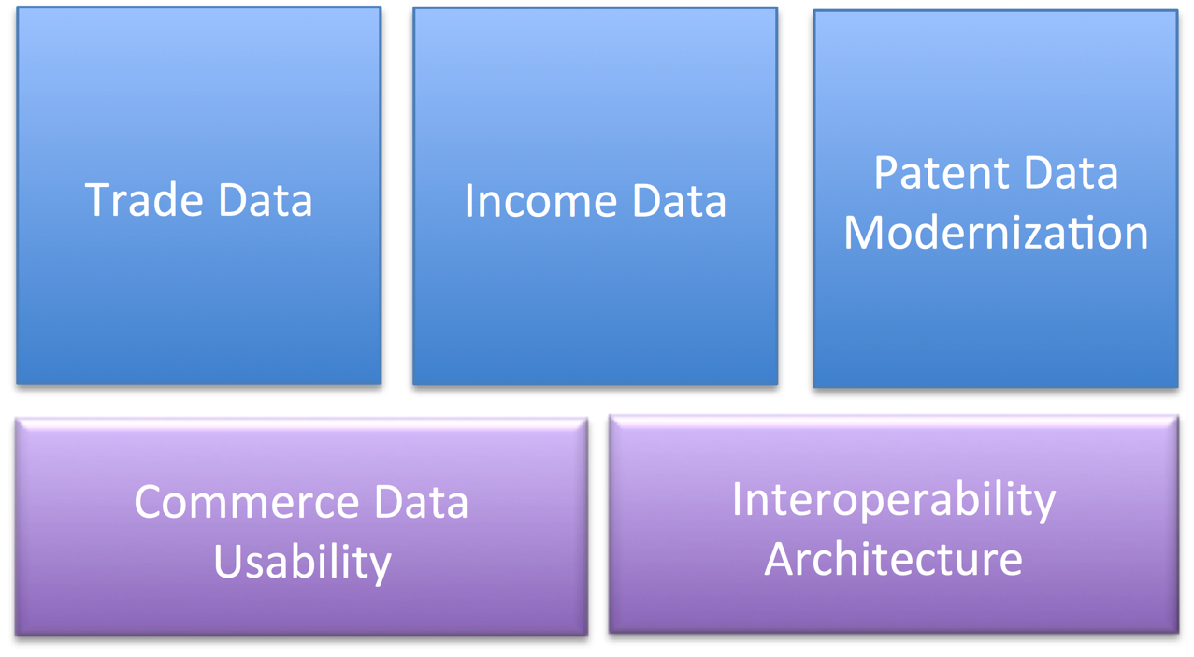
2016 CDS Project Priorities

Slide 23
2016 CDS Funding Bureaus

Slide 24
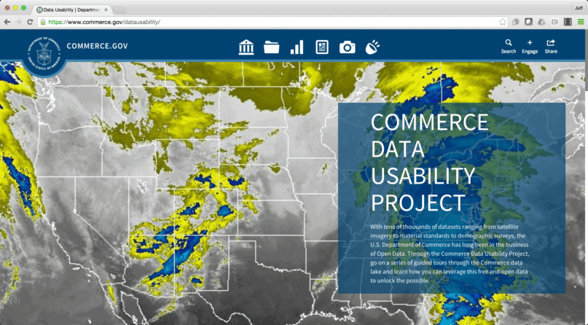
Commerce Data Usability Project
commerce.gov/datausability

Slide 25
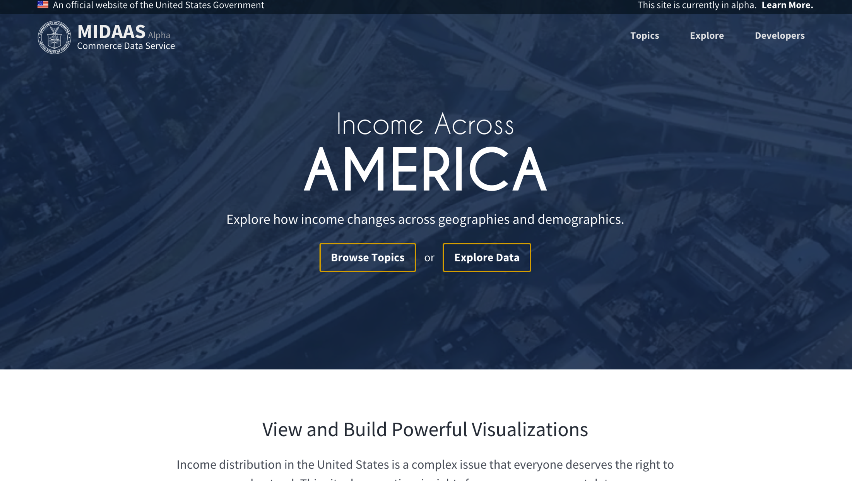
The MIDAAS Project
https://midaas.commerce.gov

Slide 26
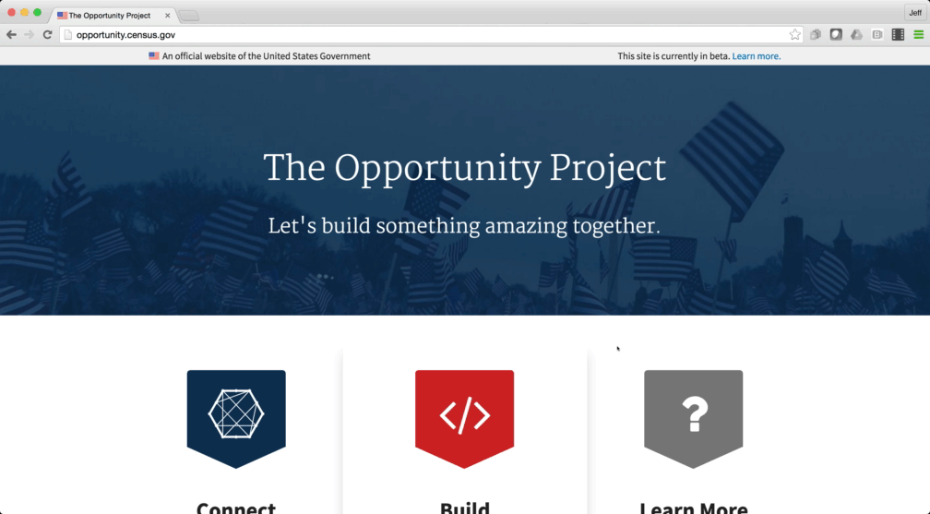
The Opportunity Project
opportunity.census.gov

Slide 27
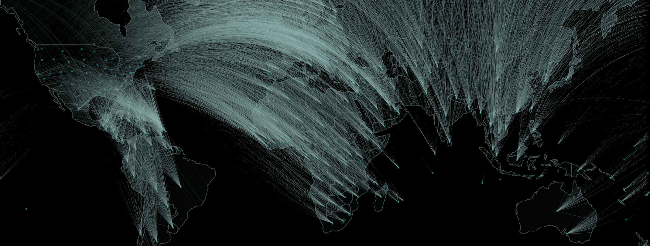
New Exporters Initiative
Inform new strategies for communicating and connecting with businesses to encourage exporting
Serve as a testbed for optimizing how services are offered and delivered to businesses across different industries
Operationalize a vision for data-driven government

Slide 28

Help Girls of Color
http://www.helpgirlsofcolor.org

Slide 29
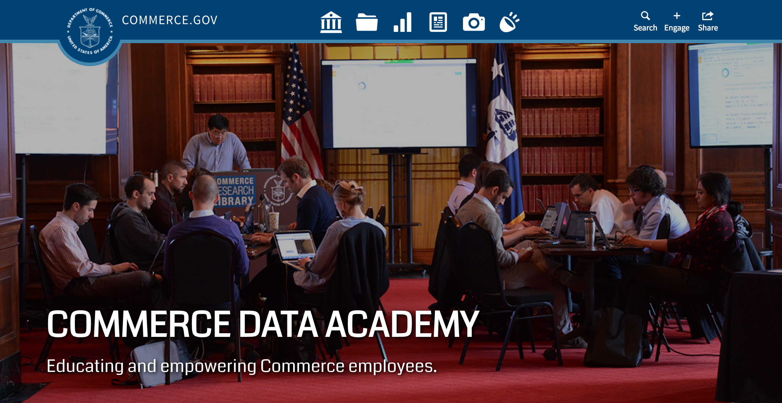
Commerce Data Academy
http://DataAcademy.commerce.gov

Slide 30
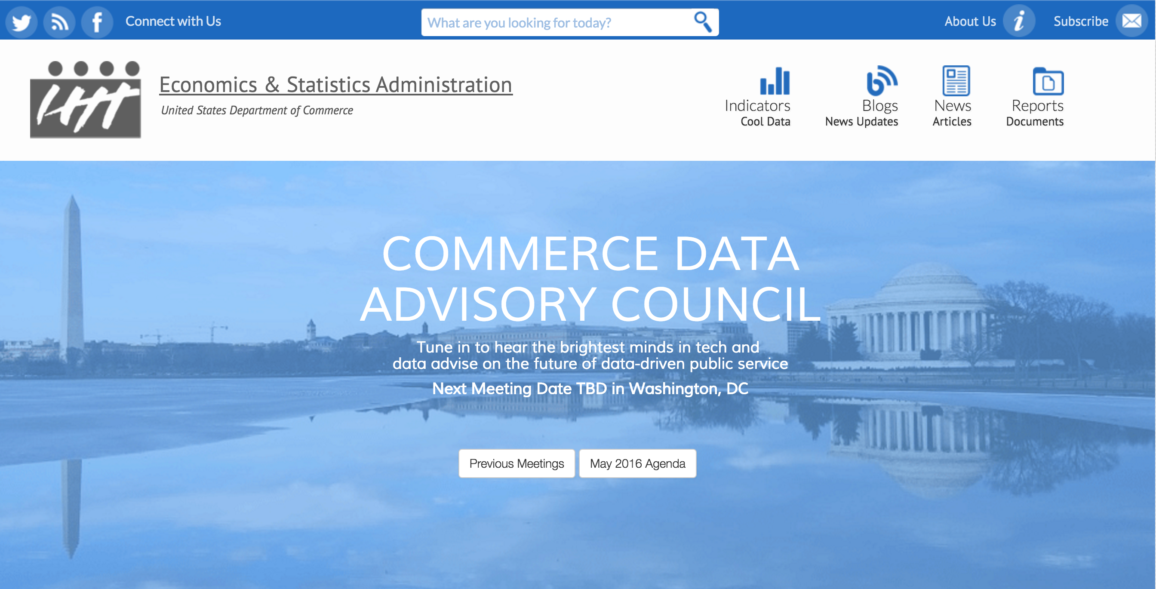
Commerce Data Advisory Council
http://esa.gov/cdac

Slide 31
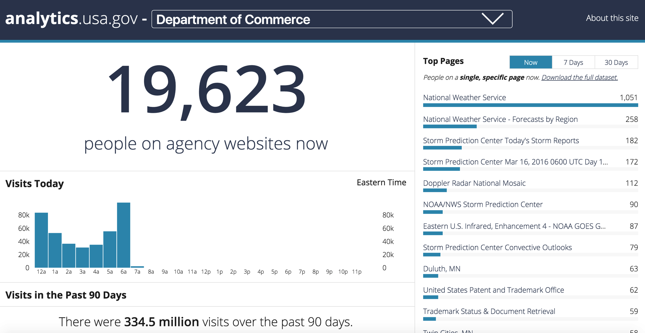
DOC Web Analytics Dashboard
https://analytics.usa.gov/commerce/

Slide 32
Delivering
BEA RIMSS Web ReDesign
Patent Data
Big Data Science Models
Infrastructure for Data Science projects
NIST
NetZero House
MEP
CENSUS

Slide 33
Welcome to the Team !

Slide 34


Questions?
PEople TO Contact
Ian Kalin
Chief Data Officer
ikalin@doc.gov
Dr Tyrone Grandison
Deputy Chief Data Officer
tgrandison@doc.gov

Slide 35
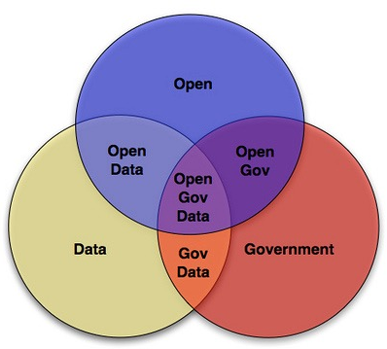
Background Materials

Slide 36
The Twelve Principles of the Agile Manifesto
Agile Principles and Practices
Lean Product Design
Why Build, Measure, Learn – isn’t just throwing things against the wall to see if they work – the Minimal Viable Product
User-Centered Design Basics
U.S. Digital Services Playbook
U.S. Web Design Standards
How to Work Open

Slide 37
18F Delivery: Partnership Playbook
Github for Beginners
GitHub's Git Cheat Sheet
Github Guides
Mastering Markdown
A Successful Git Branching Model
Getting Started with Waffle.io
18F Open Source Guide
18F Front-End Guides

Slide 38
18F Development Environment Guide
18F Automated Testing Playbook
18F API Standards
18F Analytics Standards
18F Accessibility Guide

Slide 39




commerce.gov/dataservice
data@doc.gov
@CommerceGovData

